Slide 1

Azharuddin Mohammad
Christopher James
Kiran Reddy Kancharla
Jiaxing Liu

Slide 2




Online Bookstore
Ordering books.
Display information
Create and process orders
Cart management
User management
Users
Customers
Employees/Administrators

Slide 3

Plan
Requirements – (9/27/16 – 10/11/16)
Plan – (10/12/16 – 10/20/16)
Development/Implementation – (10/21/16 – 11/8/16)
Testing – (11/9/16 – 11/21/16)
Deployment/Manual/Presentation (11/22/16 – 12/6/16)

Slide 4
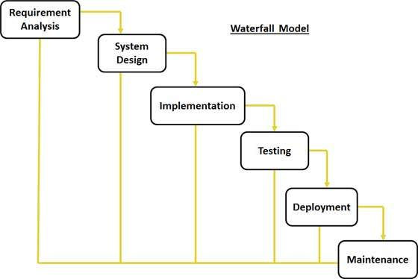
Model
Waterfall Process Model
Small Project
No uncertain requirements

Slide 5
Team Organization
Leader/Designer – Jiaxing
Developer/Presenter - Christopher
Developer/Testing - Azharuddin
Documentation/Testing - Kiran

Slide 6

System Design
Development Server
512 MB of Memory
20 GB of Storage
Ubuntu 16.04 LTS (Xenial Xerus)
Apache 2
MySQL
PHP 7.0.4
Production Server?

Slide 7

Software Design
Languages
PHP
HTML
JavaScript
SQL
CSS
Frameworks/Libraries
jQuery
cURL
Bootstrap
Stripe

Slide 8
Interface Design

Slide 9
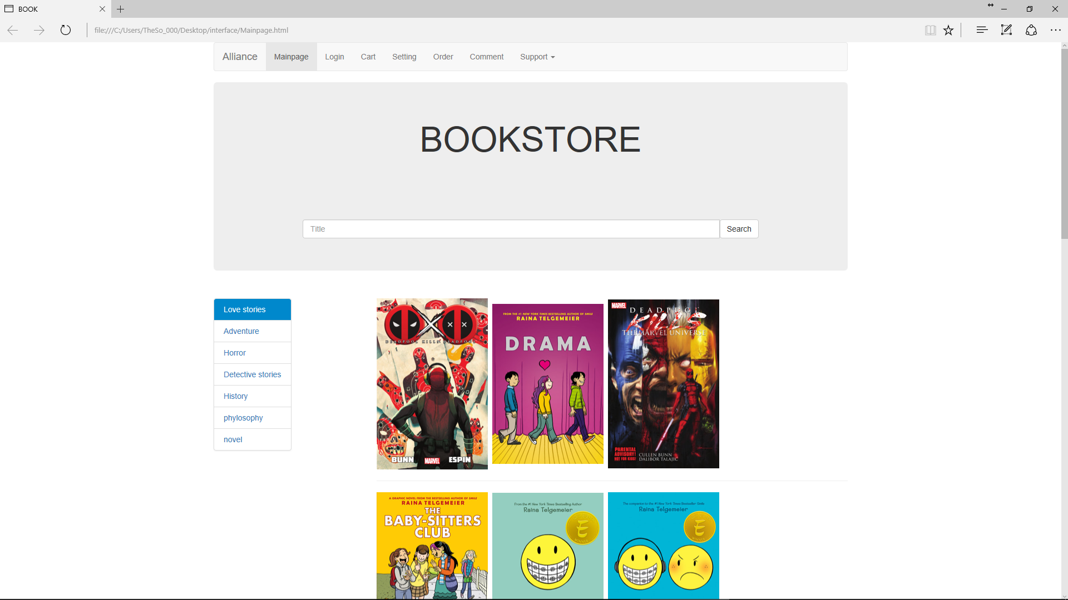
Interface Design

Slide 10
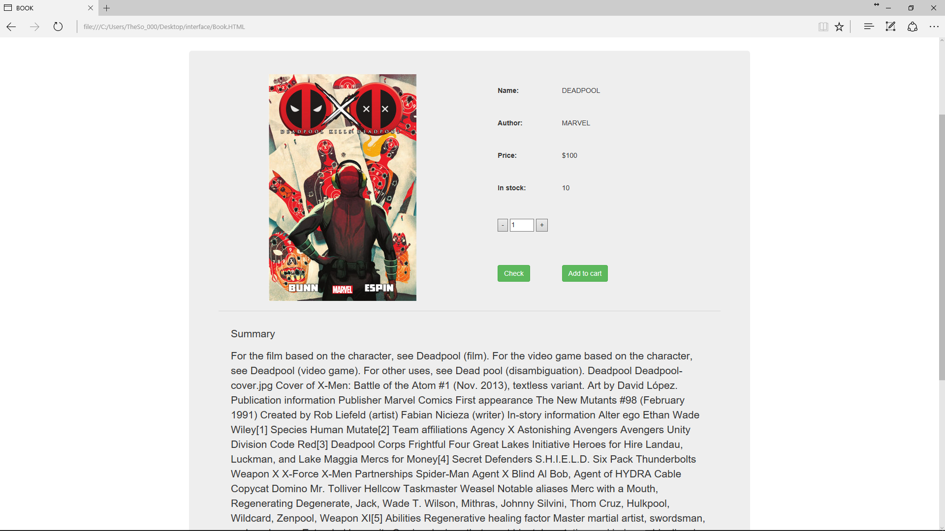
Interface Design

Slide 11
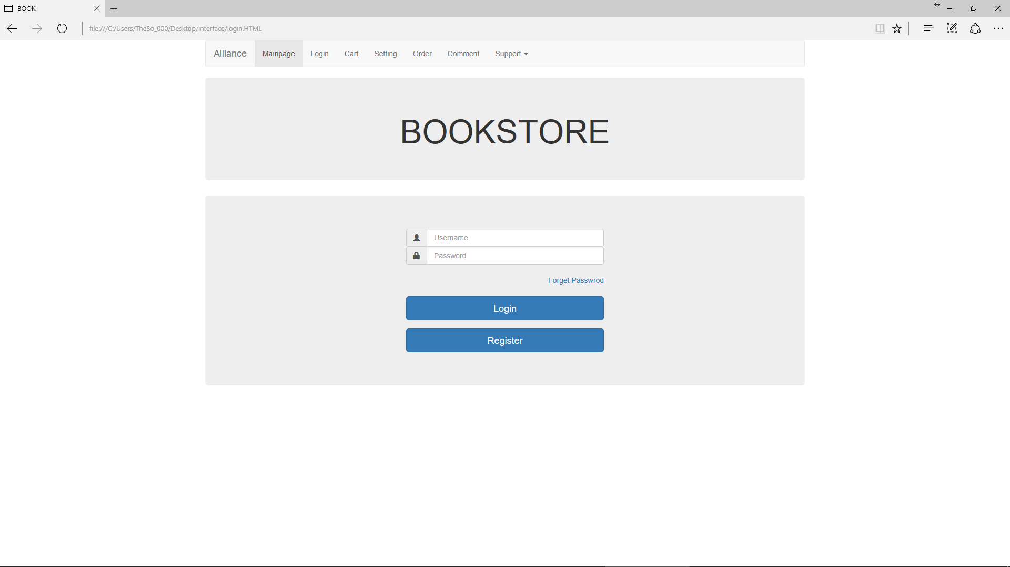
Interface Design

Slide 12
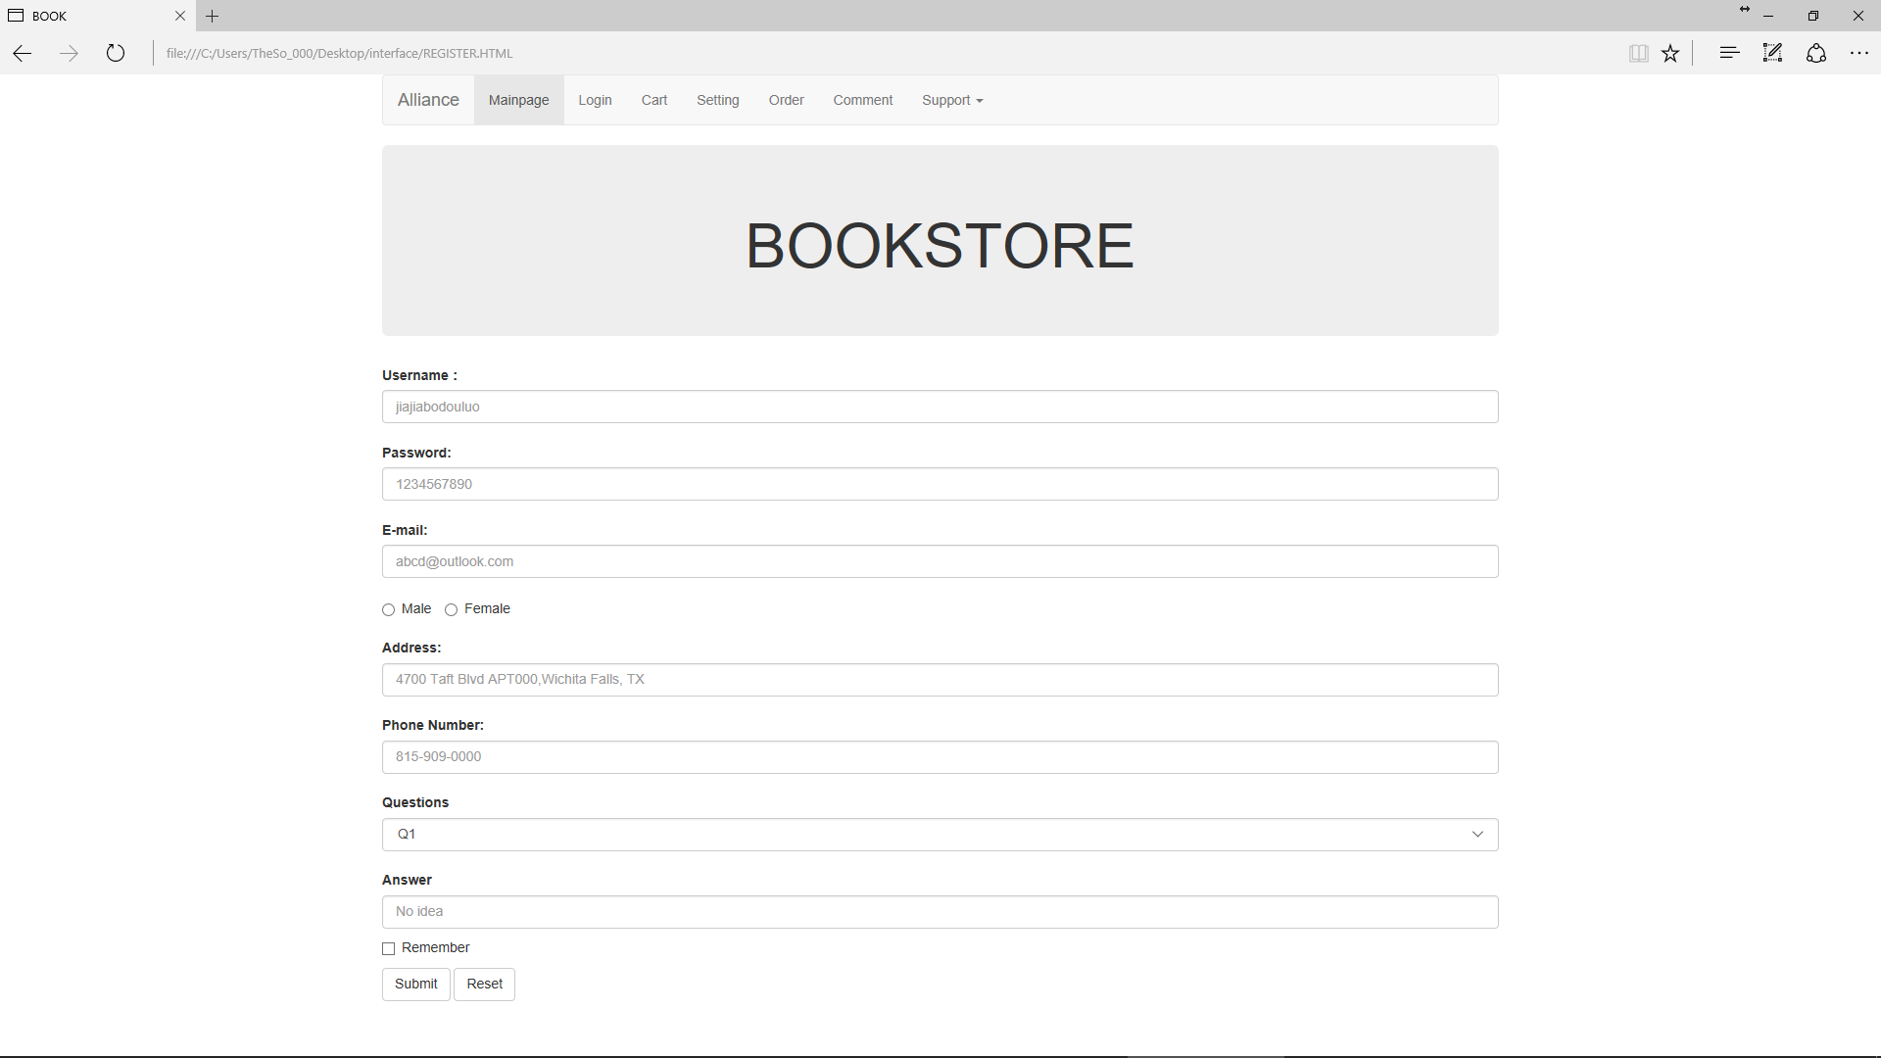
Interface Design

Slide 13
Our Work So Far
Documentation
Interface Design
Server setup
Domain registration: http://alliancedev.xyz
Security Certificate
General Research

Slide 14

What is next?
Development
Testing
Deployment
Maintenance

Slide 15
References
[1] How to install a LAMP stack on Ubuntu. https://www.digitalocean.com/community/tutorials/how-to-install-linux-apache-mysql-php-lamp-stack-on-ubuntu
[2] Ubuntu 16.04 LTS - Xenial Xerus. https://wiki.ubuntu.com/XenialXerus/ReleaseNotes
[3]. Sommerville I., Software Engineering 10th edition, Delhi, Pearson Education, Ltd, 2015.
[4]. Pressman Roger S., Software Engineering – A Practitioner’s Approach 7th edition, New York, McGraw-Hill, 2010.

Slide 16

Questions?

Slide 17
“Developing the future together.”

